Slide 1
The BLE-Enabled Sensor Cruncher
Dave Blevins
Zihui Wang
Wayne Fang
Sudheendra Sampath
November 2014

Slide 2
Concept
Implement bi-directional communications between a sensor-equipped mbed board and an iPhone, using Bluetooth Low Energy for communications
Sensors are
  Flex sensor, whose resistance varies as the strip is bent back and forth
  Temperature sensor
In addition, a slider control in the iPhone app controls the value shown on LED hexadecimal displays connected to mbed

Slide 3
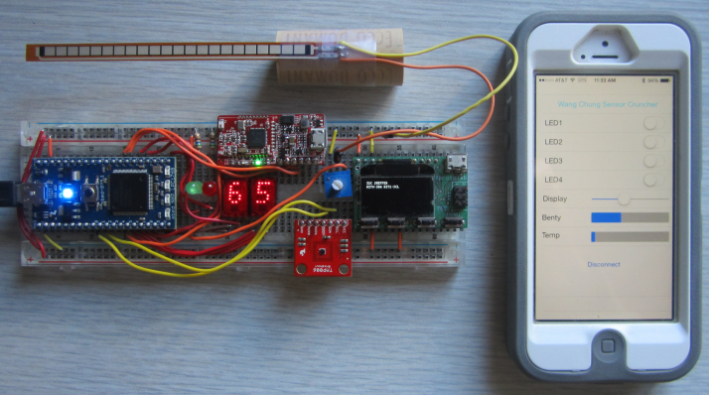
Hardware
Flex Sensor
Red Bear Labs
BLE board
HP Hexadecimal
Displays
Min/Max
LEDs
Xprotolab Oscilloscope/
Protocol Sniffer
(for debug)
Temperature
Sensor

Slide 4
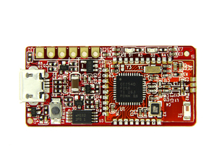
Red Bear Labs MiniBLE
Bluetooth Low Energy board
Simple UART tx/rx interface
Defaults to 57,600 baud
Can be flashed with various firmwares for different functionality
Uses TI CC2540 Bluetooth SoC
Serial bluetooth( p28, p27 );
bluetooth.baud( 57600 );
char charCent, buf;
Int cent;
sprintf( charCent, "T%.ft", cent );
bluetooth.puts( charCent );
if( bluetooth.readable() )
buf=bluetooth.getc();

Slide 5
Bluetooth Low Energy
Not mentioned in textbook
Not backward-compatible with “Classic Bluetooth”
Part of Bluetooth 4.0 spec; devices can implement BLE and/or Classic
Pairing not required
Not voice-capable
Bit rate = 1Mbit/sec
Max current draw is about ½ that of Classic

Slide 6
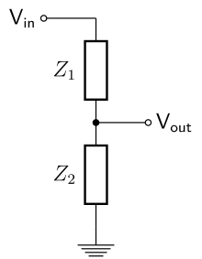
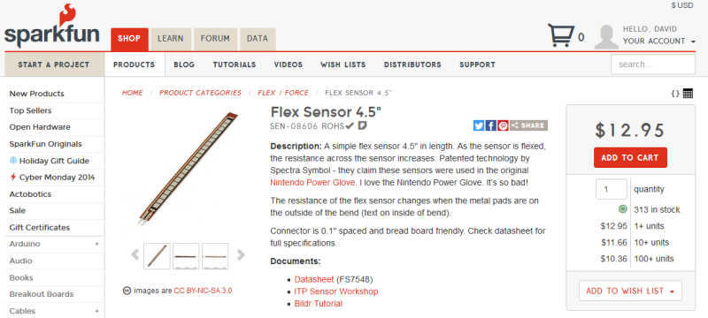
Flex Sensor
Simple, 2 pin variable resistor
Part of a voltage divider whose output is connected to an mbed analog input pin
Flex sensor
AnalogIn bendy(p20);
flexValue = bendy;
To mbed pin 20
10K potentiometer

Slide 7
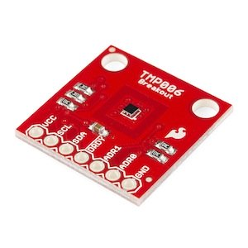
Contactless Temperature Sensor
Sparkfun TMP006
-40°C ➔ +125°C range
Employs a “Thermopile”
I2C interface
#define Address 0x80
TMP006 sensor( p9, p10, Address );
cent = sensor.readObjTempC( Address );

Slide 8
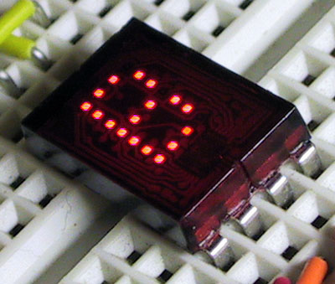
HP Displays
1999-vintage 5x7 pixel hex displays
Built-in hex converter chip
4 pins ➔ 16 possible display values
5V logic

Slide 9
HP Display Code
DigitalOut one28(p21), sixty4(p19),
thirty2(p18), sixteen(p17);
DigitalOut eight(p16), four(p15),
two(p14), one(p13);
buf = bluetooth.getc();
one28 = (int)buf & 128;
sixty4 = (int)buf & 64;
thirty2 = (int)buf & 32;
sixteen = (int)buf & 16;
eight = (int)buf & 8;
four = (int)buf & 4;
two = (int)buf & 2;
one = (int)buf & 1;

